Slide 1

KKBOX 如何使用 mrjob 連結
Python, hadoop, aws
Aaronlin

Slide 2

About KKBOX

Slide 3

About KKBOX

Slide 4


Slide 5


為音樂愛好者創造最全面性的音樂體驗
透過網路與技術的創新，提供歌手藝人與他們的音樂更多宣傳平台、管道

Slide 6


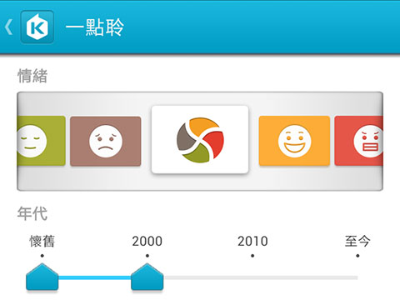
About me
Aaron Lin
研究中心頭子
aaronlin@kkbox.com
http://about.me/aaron.yclin
KKBOX 研究中心過去成果

Slide 7
為什麼今天會有這場演講？

Slide 8

一切就來自於
科科科技面對到的科科難題

Slide 9



MORE THAN
10 MILLION
USERS

Slide 10

MORE THAN
10 MILLION SONGS

Slide 11
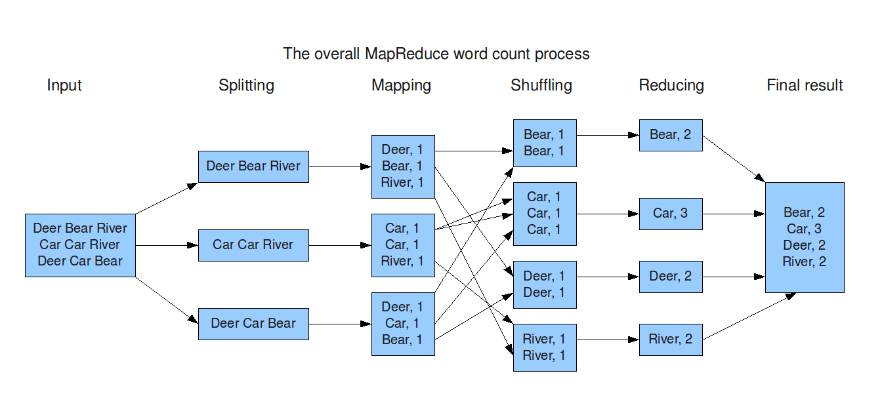
兩團巨量資料交會之下
Need to use map-reduce to perform experiments
map-reduce: map → sort → reduce

Slide 12
為什麼要使用 mrjob?
What is mrjob
Open source project founded by Yelp
https://github.com/Yelp/mrjob
Docs: https://pythonhosted.org/mrjob/
A python library for writing map-reduce job
Can cooperate with hadoop cluster and AWS very easily

Slide 13
為什麼要使用 mrjob?
Why python?
Because of we love python
Why AWS Elastic MapReduce (EMR)?
if hadoop cluster has no resources left, use EMR
If hadoop cluster cannot finish the job in time, use EMR
mrjob can audit your expense and effectiveness of each job

Slide 14
First mrjob program
Three steps
Define your question into map-reduce
Write your mapper(s)
Write your reducer(s)
That’s it!

Slide 15
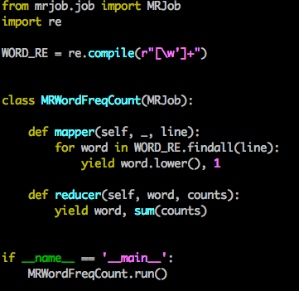
First mrjob program

Slide 16
First mrjob program
mrjob can run in three ways
Locally
Hadoop
AWS EMR

Slide 17
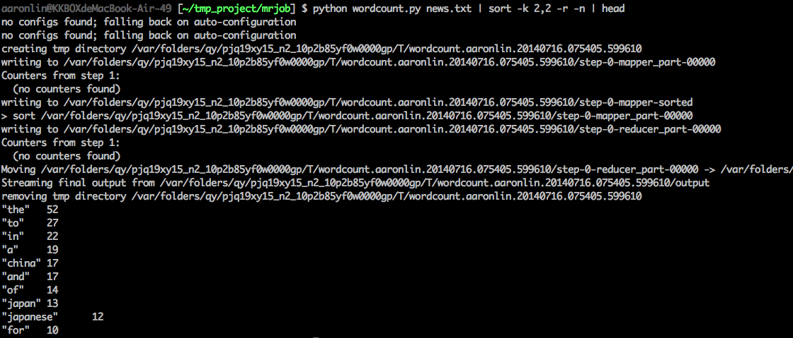
Run mrjob locally
Either way works
python wordcount news.txt
cat news.txt | python wordcount.py
cat news.txt | python wordcount.py --mapper | sort | python wordcount.py --reducer

Slide 18
Run mrjob locally
Easy to test since mapper/reducer can be run individually
cat news.txt | python wordcount.py --mapper
cat news.txt | python wordcount.py --mapper | sort | python wordcount.py --reducer
Good for Development

Slide 19
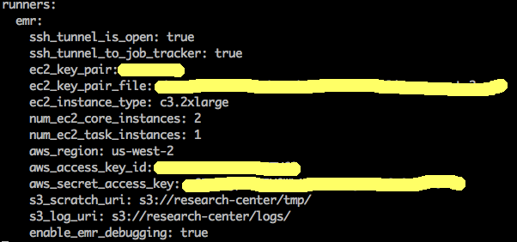
Run mrjob in EMR
Write .mrjob.conf in HOME folder

Slide 20
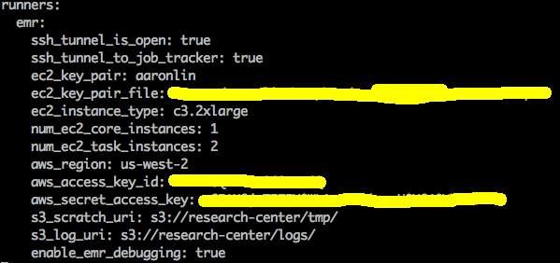
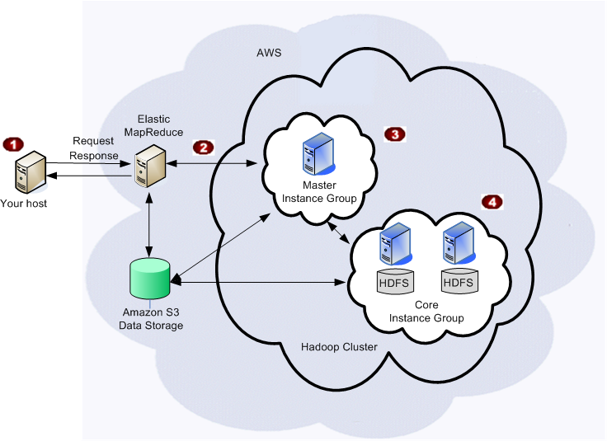
Instance type of each group
m1.small
task
c3.2xlarge
c3.2xlarge

Slide 21
Run mrjob in EMR
Use -r to specify the runner
python wordcount.py -r emr news.txt
python wordcount.py -r emr s3://xxxx/news.txt

Slide 22
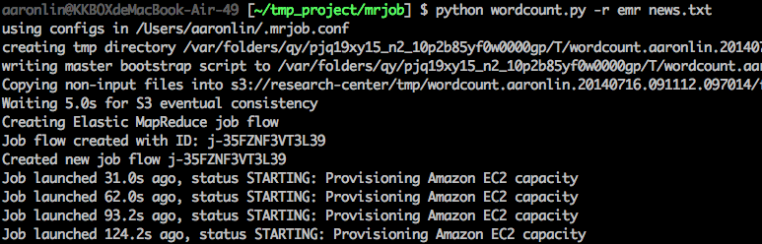
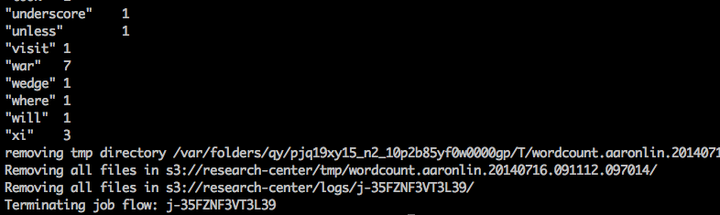
Run mrjob in EMR

Slide 23
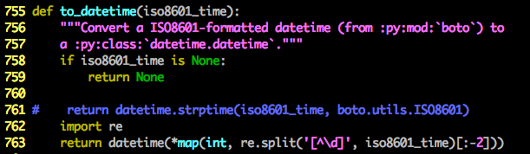
Run mrjob in EMR
How to audit emr usage
mrjob audit-emr-usage
If you have ValueError due to mismatched datetime format
Fix it in <mrjob folder>/audit_usage.py

Slide 24
但使用上總還是有些問題得先解決

Slide 25


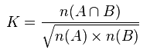
Let’s try to find related artists
A-Mei vs Hebe

Slide 26
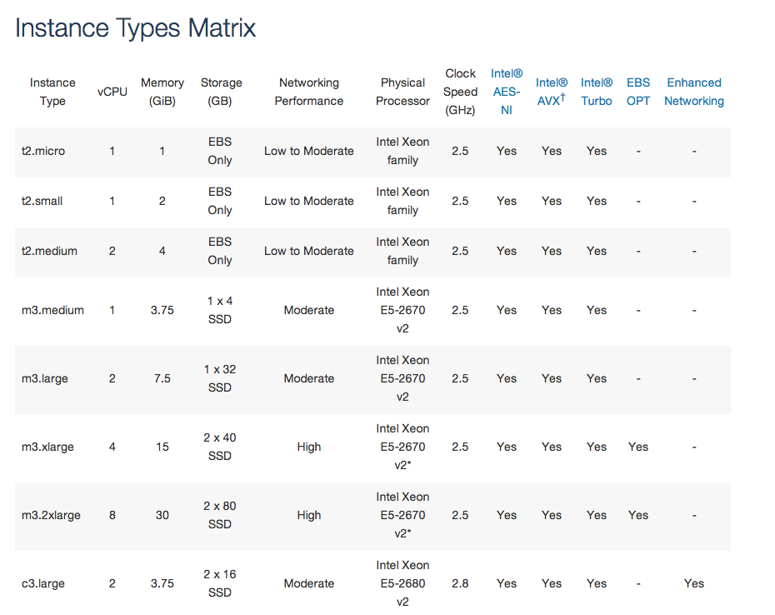
悲劇
Write a cool program to compute it
But we don’t know which AWS instance type is the best

Slide 27


Slide 28
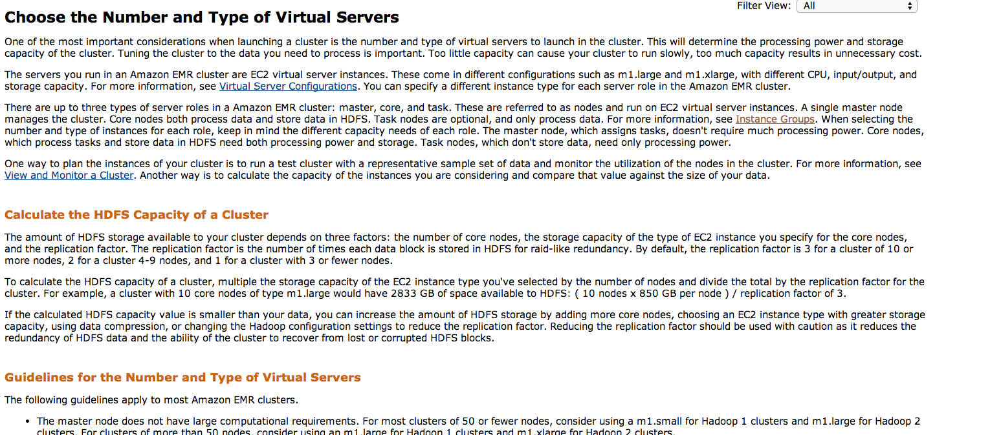
If you check the official document
http://docs.aws.amazon.com/ElasticMapReduce/latest/DeveloperGuide/emr-plan-instances.html

Slide 29


Slide 30
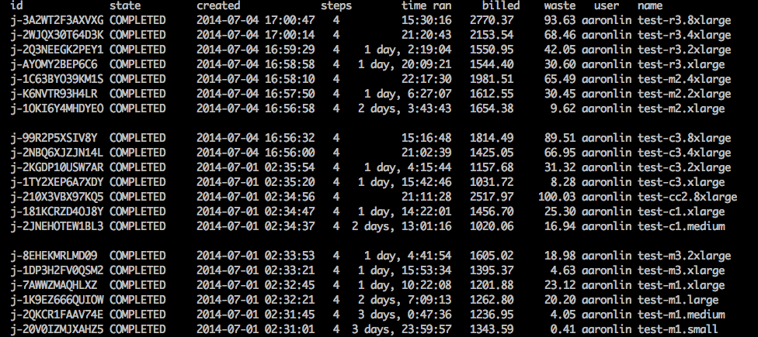
I like brute force…
Memory
optimized
Compute
optimized
General
purpose

Slide 31
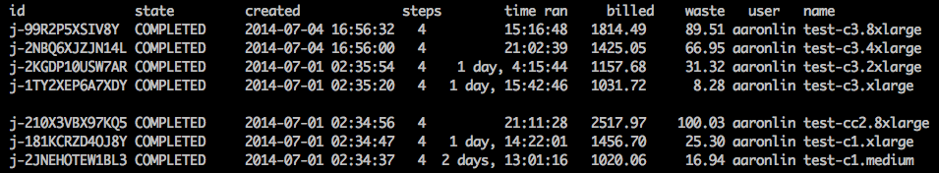
Focus on compute optimized instance
For instances with Similar Cost and same number of vCPU, Current generation instance is better

Slide 32
Focus on compute optimized instance
For instances with Similar Cost and same number of vCPU, Current generation instance is better

Slide 33
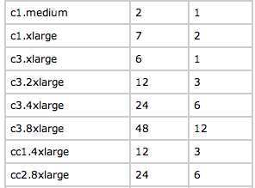
Focus on compute optimized instance
Configuration of number of mapper/reducer is different

Slide 34
Focus on compute optimized instance
Configuration of number of mapper/reducer is different

Slide 35

Conclusion
Evaluation is specific to this task
Brute force search is too lazy……
Cost about 1500 NTD per run……
Hadoop/AWS is a buzz word
The money you spend is real
Buying some low-cost computers is always an option

Slide 36
Reference
Mrjob
https://github.com/Yelp/mrjob
Docs: https://pythonhosted.org/mrjob/
Hardware spec of each instance type
http://aws.amazon.com/ec2/instance-types/
http://aws.amazon.com/ec2/previous-generation/
Number of mapper/reducer of instance type
http://docs.aws.amazon.com/ElasticMapReduce/latest/DeveloperGuide/TaskConfiguration_H1.0.3.html

Slide 37
Reference
Slides and script
https://github.com/KKBOX/coscup.tw.2014

Slide 38


z
We are hiring!
http://www.kkbox.com/jobs/

